Slide 1
Parábola

Slide 2
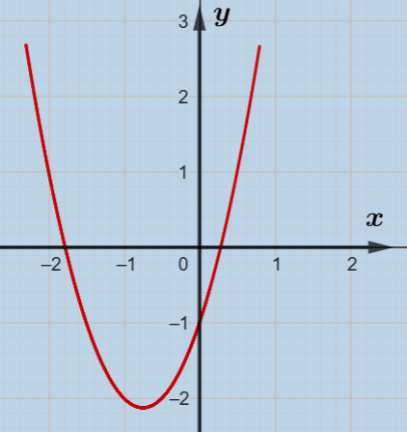
Encontre a função de segundo grau cujo gráfico encontra-se abaixo.
$$f\left(x\right)=ax^{2}+bx+c$$
$$a=?$$
$$b=?$$
$$c=?$$
$$\left(x, f\left(x\right)\right)$$
$$\left(−2, 1 \right)$$
$$\left(−1, −2 \right)$$
$$\left(0, −1 \right)$$

Slide 3
Sol.
$$f\left(−2\right)=1$$
$$⇒a.{\left(−2\right)}^{2}+b.\left(−2\right)+c=1$$
$$⇒4a −2b+c=1$$
$$f\left(x\right)=ax^{2}+bx+c$$
$$f\left(−1\right)=−2$$
$$⇒a.{\left(−1\right)}^{2}+b.\left(−1\right)+c=−2$$
$$⇒a−b+c=−2$$
$$a=?$$
$$b=?$$
$$c=?$$
$$f\left(0\right)=−1$$
$$⇒a.{\left(0\right)}^{2}+b.\left(0\right)+c=−1$$
$$⇒c=−1$$
$$\left(x, f\left(x\right)\right)$$
$$4a −2b+c=1$$
$$4a −2b−1=1$$
$$4a −2b=2$$
$$\left(−2, 1 \right)$$
$$a−b+c=−2$$
$$a−b−1=−2$$
$$a−b=−1$$
$$\left(−1, −2 \right)$$
$$c=−1$$
$$\left(0, −1 \right)$$
$$a−b=−1$$
$$4a −2b=2$$
$$a=b−1$$
$$a=b−1$$
$$4b−4 −2b=2$$
$$a=2$$
$$2b=6$$
$$b=3$$

Slide 4
Sol.
$$f\left(−2\right)=1$$
$$⇒a.{\left(−2\right)}^{2}+b.\left(−2\right)+c=1$$
$$⇒4a −2b+c=1$$
$$f\left(x\right)=ax^{2}+bx+c$$
$$f\left(−1\right)=−2$$
$$⇒a.{\left(−1\right)}^{2}+b.\left(−1\right)+c=−2$$
$$⇒a−b+c=−2$$
$$a=?$$
$$b=?$$
$$c=?$$
$$f\left(0\right)=−1$$
$$⇒a.{\left(0\right)}^{2}+b.\left(0\right)+c=−1$$
$$⇒c=−1$$
$$\left(x, f\left(x\right)\right)$$
$$4a −2b+c=1$$
$$4a −2b−1=1$$
$$4a −2b=2$$
$$\left(−2, 1 \right)$$
$$a−b+c=−2$$
$$a−b−1=−2$$
$$a−b=−1$$
$$\left(−1, −2 \right)$$
$$c=−1$$
$$\left(0, −1 \right)$$
$$a−b=−1$$
$$4a −2b=2$$
$$a=b−1$$
$$a=b−1$$
$$4b−4 −2b=2$$
$$a=2$$
$$2b=6$$
$$b=3$$
$$∴f\left(x\right)=2x^{2}+3x−1$$

